Slide 1


Prep4Tests
Exam test questions made easier
Notes:
Hey, this is our team and all of us are university students. And somewhere between 2 to 4 times a year, we are faced with something really terrible and we all hate it - exams. We are too busy doing other important things, and this just drains us, especially if we are failing them again and again. So we asked ourselves, how could we overcome this period more easily, is there anything to improve?

Slide 2
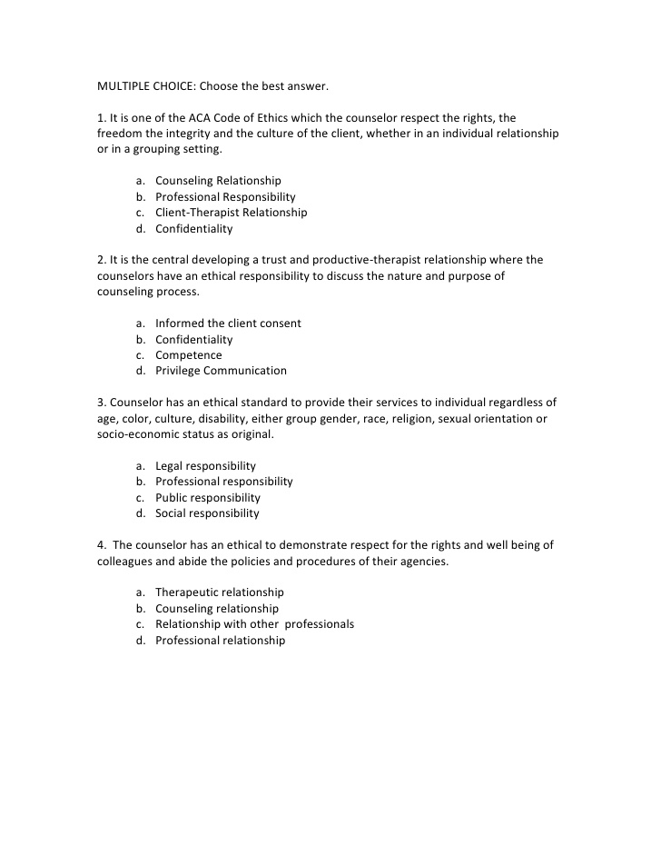
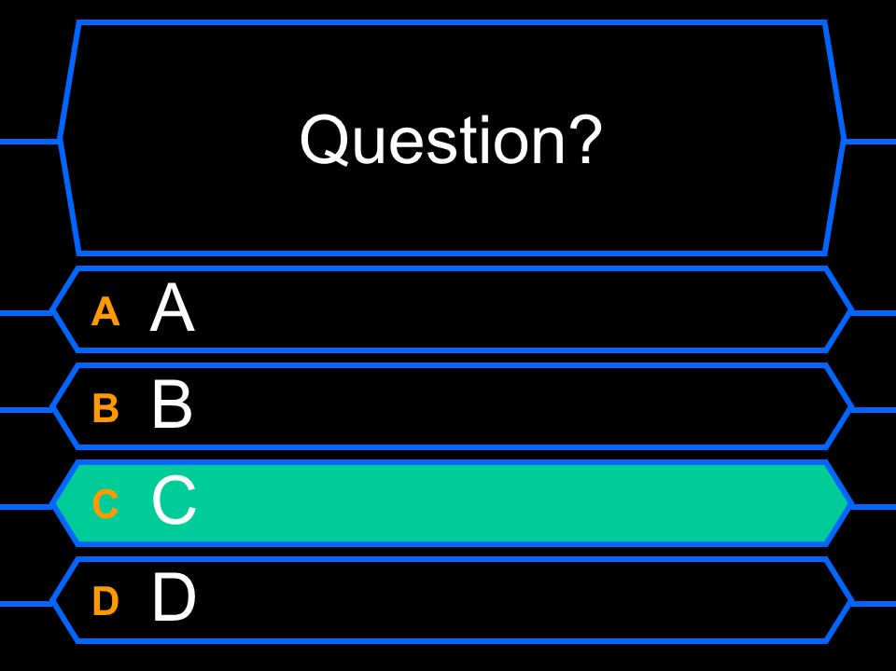
Notes:
We realized, that many of our exams incorporate test questions, or multiple choice questions, which tend to repeat themselves over the years, since the curriculum is of a definite length for a given subject, or that they still serve as a great studying material containing the most important information to be taken away from the class.
Problem formulation: Studying from the tests is very useful, however, there could be a way of doing this efficently and effectively.

Slide 3

Providing more efficient studying for students by the introduction of a test questions application.
Notes:
Our solution. &move to the demo asap.

Slide 4
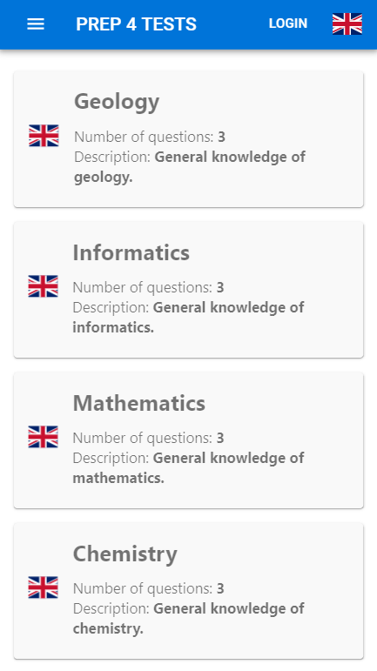
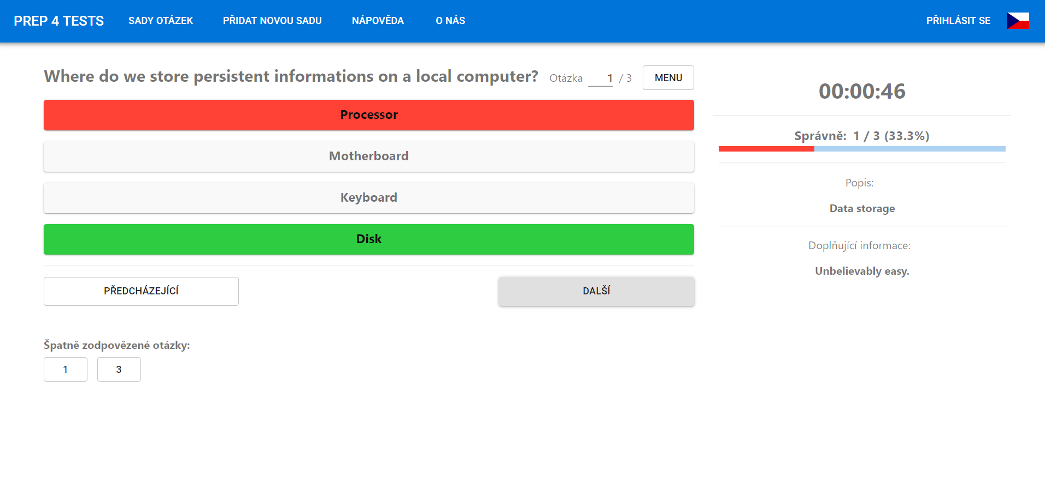
Notes:
Demo.

Slide 5
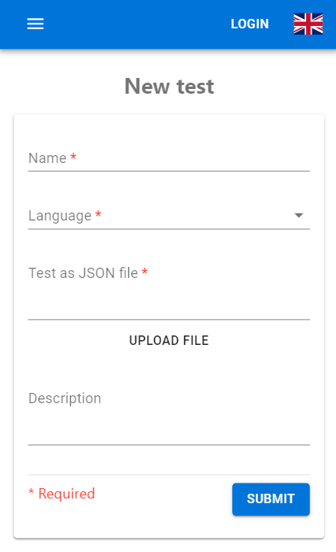
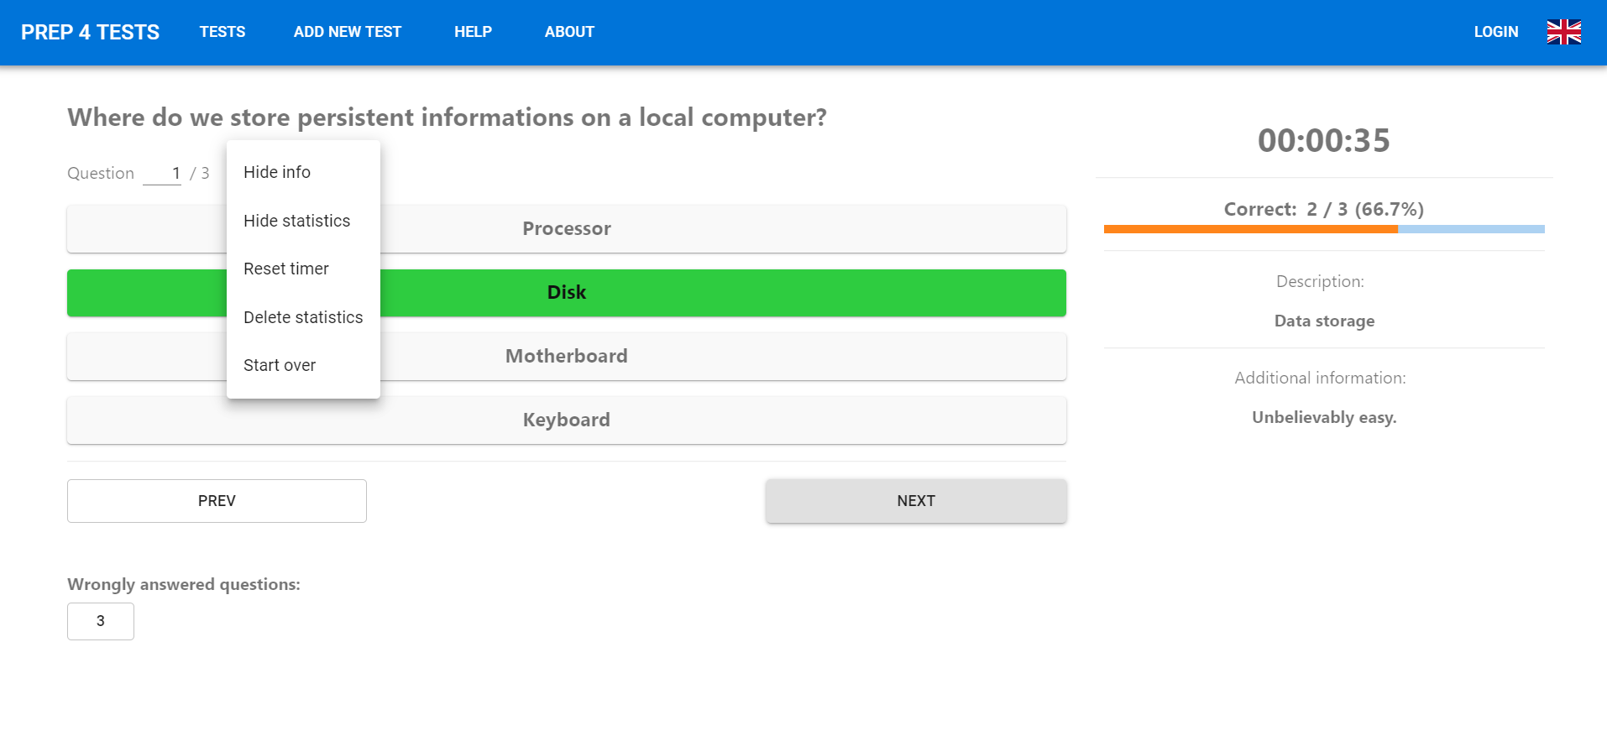
Notes:
Demo.

Slide 6
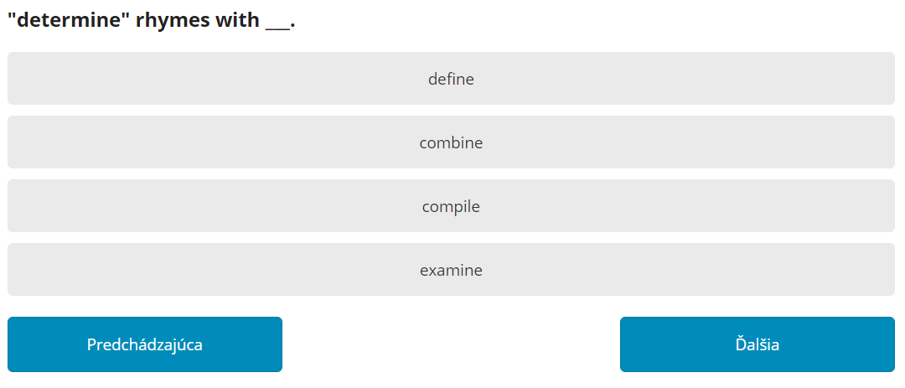
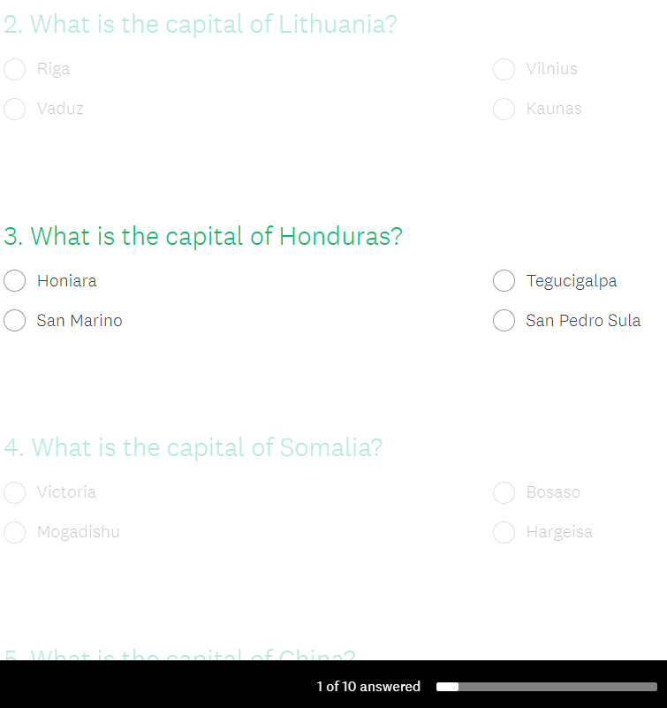
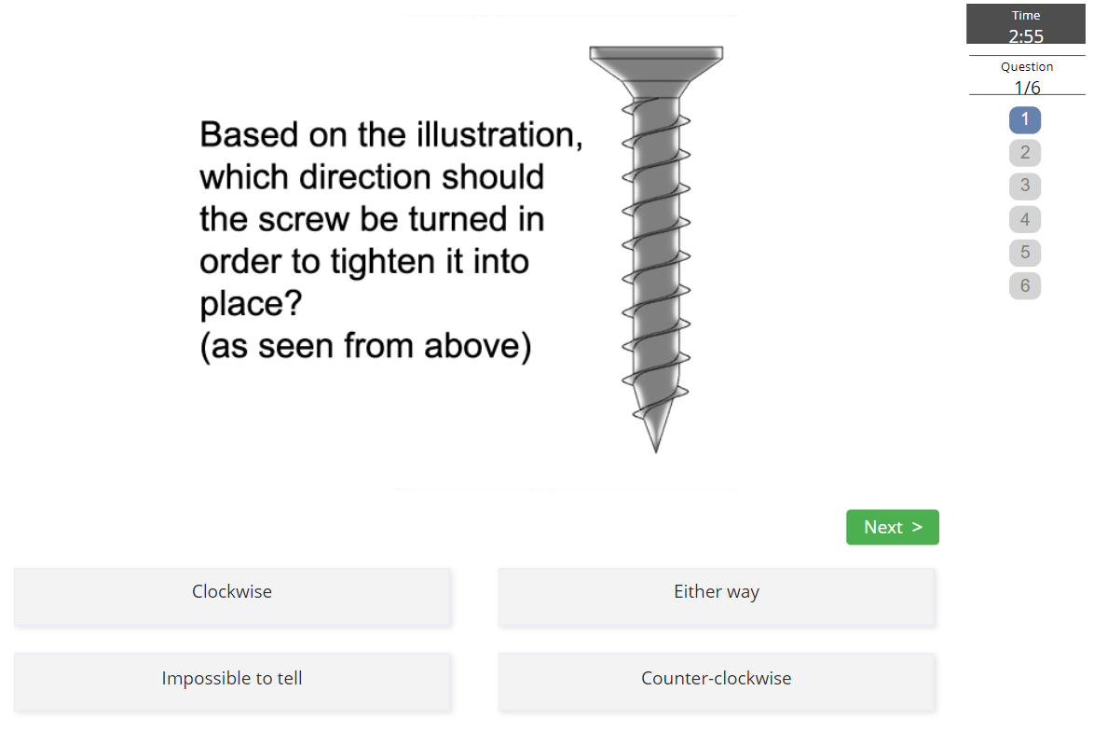
Notes:
Differentiation (USP) - niche product & such tools are already popular at the faculty (e.g. Kabell’s solution, which was an inspiration for us and we added extra features to it). It’s a local thing and building on this fact gives us a huge advantage.
The way people are using these tests is quite unique and the other apps don’t allow such functionality.

Slide 7





Notes:
Monetization - we will see… freemium or maybe revenue from ads or maybe donations...
Opportunization - there is an opportunity to spread it to other faculties and universities, we already talked to fellow students from VUT and MENDELU and they were really interested in using such a tool for a couple of classes, where tests questions have been used.

Slide 8

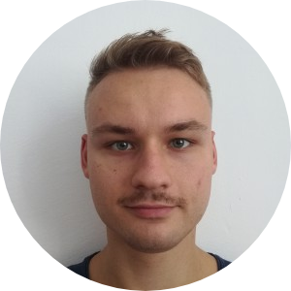



“A bunch of motivated IT guys with a selfish need to simplify their lives.”
Václav
Jan
Adrián
Tadeáš
Jirka
Backend Developer
Designer, Tester
Architect
Analyst, Tester
Frontend Developer
Notes:
Our beloved team, make it short, kinda funny, mentioned sth like “sorry for the terrible social media images”

Slide 9

Prep4Tests
Helping students pass their exams easier
Notes:
Thxx

